Slide 1
Machine learning 101 Session 4

Slide 2

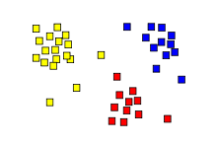
Revision
Labeled Data
Machine Learning algorithm
Training
Prediction
Labeled Data
Learned model
Prediction
class A
class A
Classification
Regression
Clustering

Slide 3

Introduction to Deep Learning
Deep Learning is just a new name for deep neural networks
These models have proven to have better accuracy than others on common tasks
Especially popular for computer vision applications

Slide 4
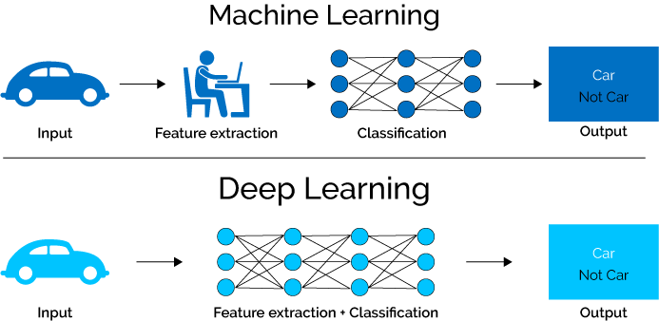

Slide 5
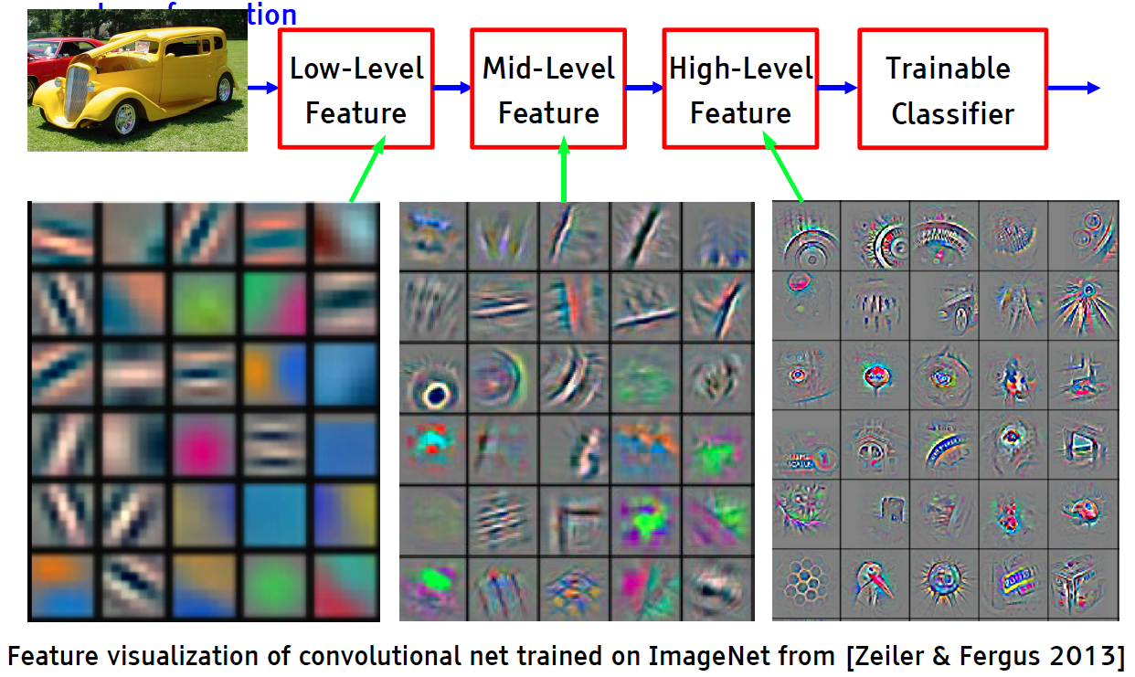
Deep Learning: Hierarchical representations
5

Slide 6
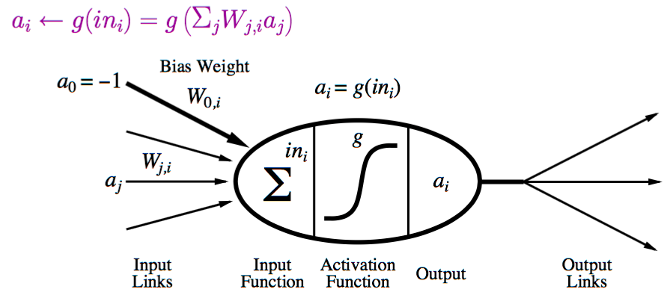
Neural Network
Layers of neurons
Each neuron sums the inputs and applies a nonlinear function

Slide 7
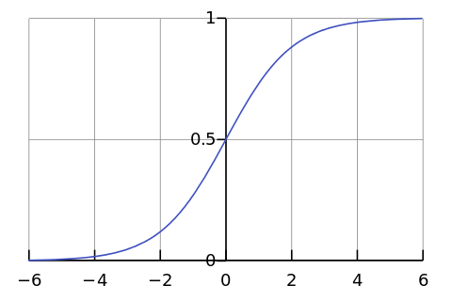

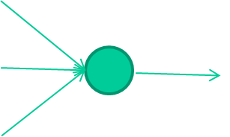
-0.06
W1
W2
f(x)
-2.5
W3
1.4

Slide 8
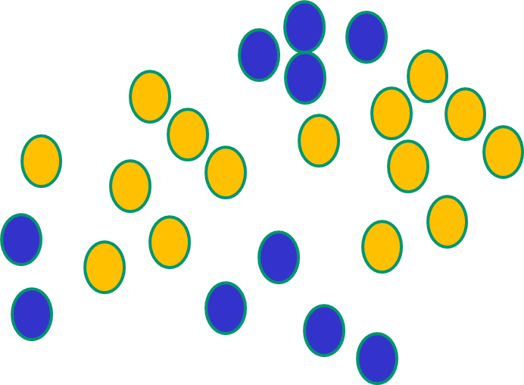
Some other ‘by the way’ points
NNs use nonlinear f(x) so they SVMs only draw straight lines,
can draw complex boundaries, but they transform the data first
but keep the data unchanged in a way that makes that OK

Slide 9
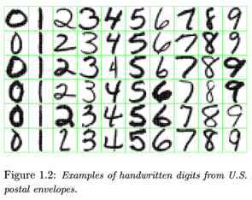
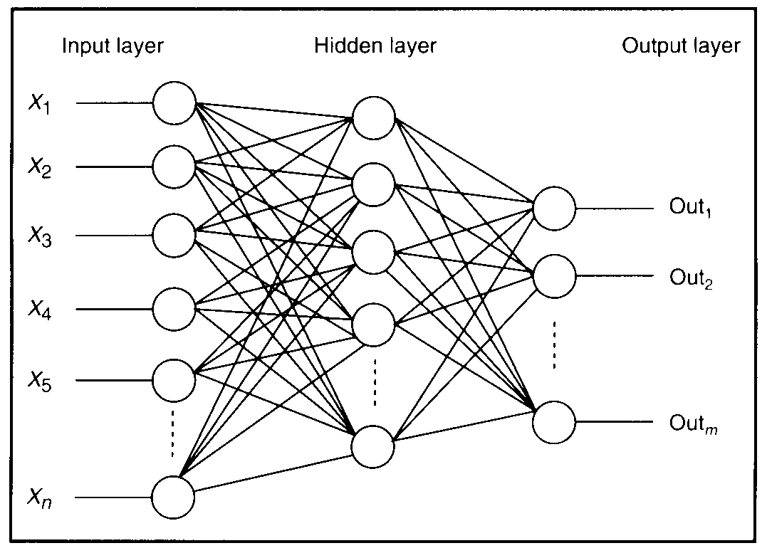
Feature detectors

Slide 10
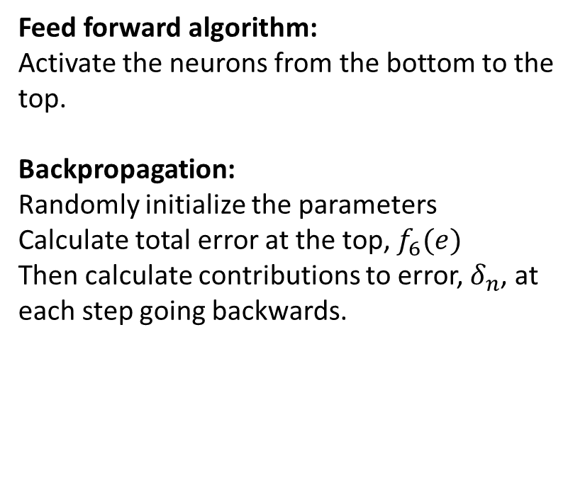
Backpropagation
Feed forward algorithm:
Activate the neurons from the bottom to the top.
Backpropagation:
Randomly initialize the parameters
Calculate total error at the top, $f_{6}(e)$
Then calculate contributions to error, $δ_{n}$, at each step going backwards.
10

Slide 11
Fat + Short v.s. Thin + Tall
The same number of parameters
Which one is better?
……
……
……
Shallow
Deep

Slide 12
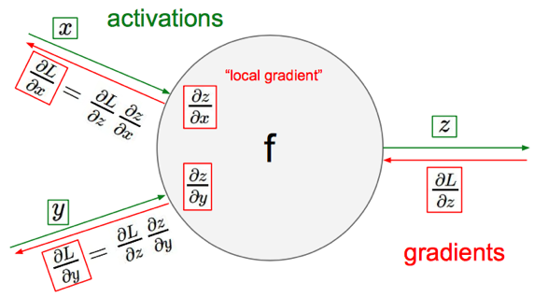


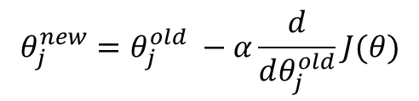
Gradient Descent
objective/cost function $J(θ)$
Review of backpropagation
$$θ_{j}^{new}=θ_{j}^{old} −α\frac{ⅆ}{ⅆθ_{j}^{old}}J(θ)$$
Update each element of θ
$$θ_{}^{new}=θ_{}^{old} −α∇_{θ}J(θ)$$
Matrix notation for all parameters
learning rate
Recursively apply chain rule though each node
Notes:
Adaptive Gradient Algorithm (AdaGrad) that maintains a per-parameter learning rate that improves performance on problems with sparse gradients (e.g. natural language and computer vision problems).
Root Mean Square Propagation (RMSProp) that also maintains per-parameter learning rates that are adapted based on the average of recent magnitudes of the gradients for the weight (e.g. how quickly it is changing). This means the algorithm does well on online and non-stationary problems (e.g. noisy).
Adam realizes the benefits of both AdaGrad and RMSProp.
Instead of adapting the parameter learning rates based on the average first moment (the mean) as in RMSProp, Adam also makes use of the average of the second moments of the gradients (the uncentered variance).
Specifically, the algorithm calculates an exponential moving average of the gradient and the squared gradient, and the parameters beta1 and beta2 control the decay rates of these moving averages.
The initial value of the moving averages and beta1 and beta2 values close to 1.0 (recommended) result in a bias of moment estimates towards zero. This bias is overcome by first calculating the biased estimates before then calculating bias-corrected estimates.

Slide 13
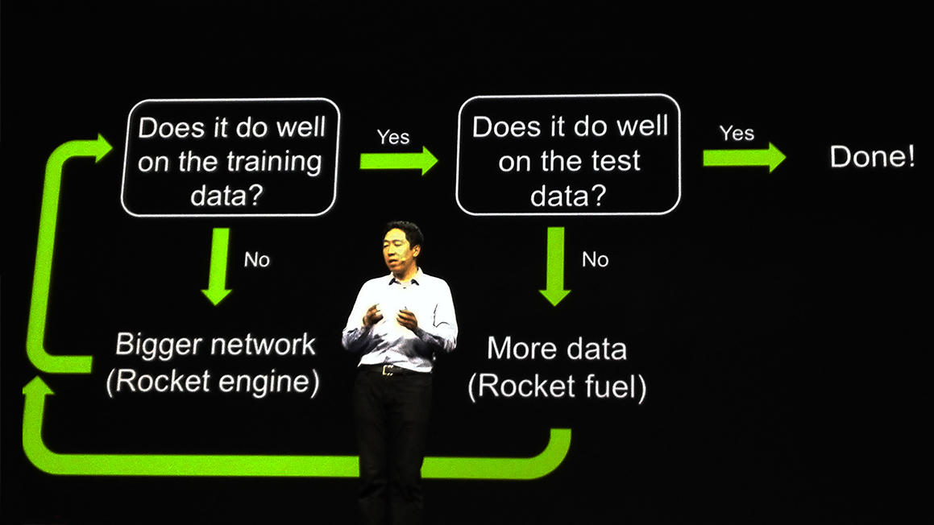
Recipe for Learning
Don’t forget!
overfitting
Modify the Network
Preventing
Overfitting
Better optimization Strategy
http://www.gizmodo.com.au/2015/04/the-basic-recipe-for-machine-learning-explained-in-a-single-powerpoint-slide/
Notes:
Last one is on training set
Sometimes students ask

